Slide 1
Last updated: 23 Sep 2020
How to:
make the most of your Conference
Welcome to share/modify
Don’t use it for profitable purposes
Dr.
Haoyang Ye
Email: haoyang.ye@cantab.net
Website: haoyangye.com/Home
Slides: https://github.com/zoeye859/Workshop
@ NJU

Slide 2
Before the workshop
1
You are not allowed to be silent. Share your ideas and talk to people around you (even if you don’t know them very well)
1
1
Ask relevant questions whenever you like - without standing up, simply raise your hand
2
1
3
Phone: volume down to minimum please
1
Leave anytime you like (don’t need to tell me that you need to go to the toilet, just go!)
4

Slide 3

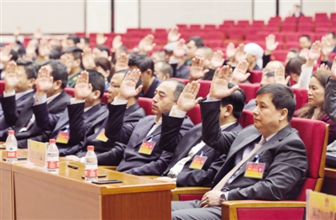
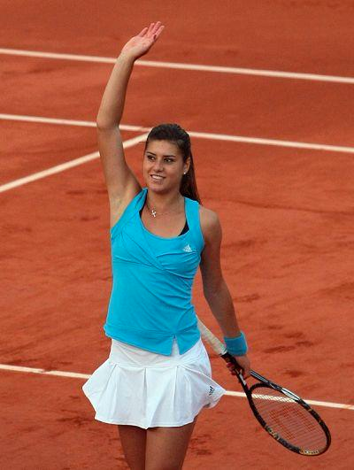
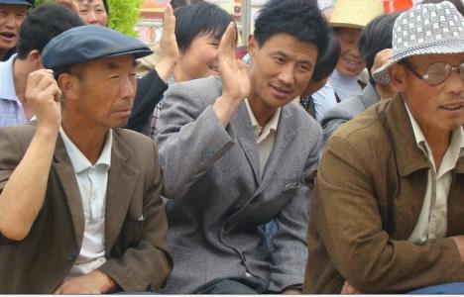

Practice 1: Raise your hand
1
Practice at least 3 styles of raising your hand, and find your favourite style!

Slide 4
Practice 1: Raise your hand
1
Now please raise your hand!

Slide 5
Practice 1: Raise your hand
1
Now please raise your hand!
Remember this feeling!!!
(Practice at home until you feel comfortable raising up your hand!!)

Slide 6
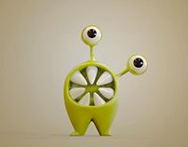
Practice 2: Brainstorming
1
Motivation: what do you want to get from this workshop?
Brainstorming:
Voice your ideas without consequences -
no one should judge your idea during brainstorming, including yourself!

Slide 7
Practice 2: Brainstorming
1
Motivation: what do you want to get from this workshop?

Slide 8
Your thoughts & notes …

Slide 9
Content
1
Prepare for the conference
2
Your conference mindset
3
Social social social - how?
4
What’s next?

Slide 10
Discussion 1: Conference preparation
1
How did/will you prepare for your conference?

Slide 11
Discussion 1: Conference preparation
1
How did/will you prepare for your conference?

Slide 12
Practice 3: Plan your next conference (1)
Will you try Tip 1-5?
If not, what are your biggest fears/stress?
1
(you can discuss it with me after the workshop.)
1
3 mins to write down your preparation plan for your next
conference!

Slide 13
Your thoughts & notes …

Slide 14
Content
1
Prepare for the conference
2
Your conference mindset
3
Social social social - how?
4
What’s next?

Slide 15
Practice 4: Motivation - todo list
1
Look at our motivation list earlier

Slide 16
Practice 4: Motivation - todo list
Your motivation
Your to-do list during conference:

Slide 17
Discussion 2: Share your motivation - todo list
Your thoughts & notes …

Slide 18
Your thoughts & notes …

Slide 19
Content
1
Prepare for the conference
2
Your conference mindset
3
Social social social - how?
4
What’s next?

Slide 20
Social social and social!!!
Unfortunately, you cannot avoid this forever….
Here is a toolkit for you—
Focus on the social part. Maybe another workshop on presentation?
Start a conversation
Make new connection
Exit a conversation
Maintain a conversation

Slide 21
You make contacts to…
1
Advertise your research/paper/software…
1
Seek collaboration/visiting opportunities
1
Generate new ideas/research projects
1
Approach potential employers
1
….

Slide 22
Practice 5: your killer conversation starters
Everyone please give me a conversation starter now.

Slide 23
Practice 6: your elevator pitch
Your thoughts & notes …
Keep it compact and practice it until you can say it out
loud without hesitation/pauses

Slide 24
Practice 7: Plan your next conference (2)
Will you try Tip 8-15?
If not, what are your biggest fears/stress?
1
(you can discuss it with me after the workshop.)
1
3 mins to write down your social plan for your next
conference!

Slide 25
Your thoughts & notes …

Slide 26
Content
1
Prepare for the conference
2
Your conference mindset
3
Social social social - how?
4
What’s next?

Slide 27
Practice 8: Plan your next conference (3)
Will you try Tip 16-18?
If not, what are your biggest fears/stress?
1
(you can discuss it with me after the workshop.)
1
3 mins to write down your post-conference plan!

Slide 28
Your thoughts & notes …

Slide 29
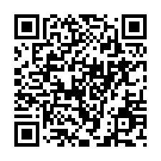
Homework
A detailed plan
Try the tips
Challenge yourself
Please add the practice notes together to organise a detailed plan for your next conference meeting
Practice the tips as often as you can in your daily life, and conference.
Push yourself to find your current limit, research to find techniques and practice them to push your limit even further.
Please fill in this short survey, your time will be much appreciated!
https://wj.qq.com/s2/7275687/01d3/

Slide 30
Further reading/watching
How to make the most of an academic conference – a checklist for before, during and after the meeting by Marta Teperek
How to Ask Better Questions | Mike Vaughan | TEDxMileHigh by Mike Vaughan
How to Ask Questions Better by Tim Ferriss
How to MAKE THE MOST of Conferences by Jessica Sainsbury

Slide 31
Questionnaire
Your feedback is very much valued!
Please fill in this short survey, your time will be much appreciated!
https://wj.qq.com/s2/7275687/01d3/

Slide 32
Last updated: 23 Sep 2020
Thank you!
Dr.
Haoyang Ye
叶昊扬
Welcome to share/modify
Don’t use it for profitable purposes
Email: haoyang.ye@cantab.net
Website: haoyangye.com/Home
Slides: https://github.com/zoeye859/Workshop
培训

Slide 33
Q&A
Dr.
Haoyang Ye
叶昊扬
Email: haoyang.ye@cantab.net
Website: haoyangye.com/Home
Slides: https://github.com/zoeye859/Workshop
培训

